Slide 1

The Low Income Household Water Assistance Program (LIHWAP)
A Primer for Social and Legal Service Providers
Elizabeth Marx, Executive Director, PULP
Brian Whorl, Division Director, Federal Programs, DHS

Slide 2
About PULP:
Mission:
Assist Pennsylvania’s low income families to connect and maintain safe and affordable utility services to their home.
Legal Representation
Policy
Advocacy
Education
Outreach
Technical Assistance

Slide 3
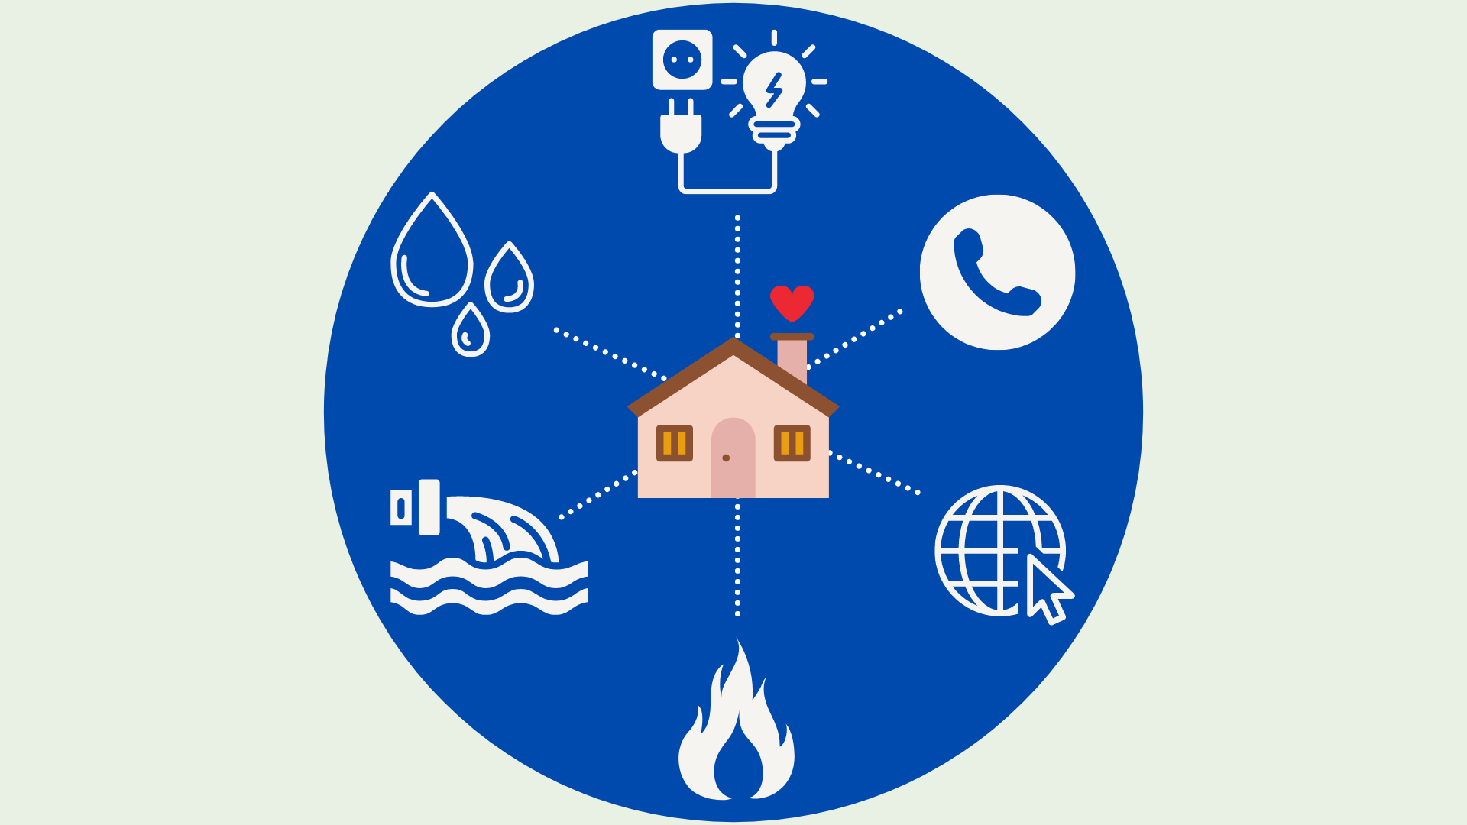
The Importance of Utility Access
Image Description: A group of utility services, like electricity and heat, surrounding and connecting to a happy and healthy home.

Slide 4
Water / WW Affordability
  Low income households pay as much as 20% of income on water / wastewater / stormwater.
    No current standardized statewide or national affordability standards for water / wastewater / stormwater.
    Poverty experts generally agree that combined water / wastewater burden should not exceed 4% of income.
    EPA has a systemwide affordability standard – 2.5% for water; 4.5% for combined water/wastewater
      EPA’s standard relies on median household income and is designed to assess the affordability of system upgrades for small water/ww systems to comply with clean water act requirements.
      EPA’s systemwide affordability standard is NOT designed to assess affordability for low income households.

Slide 5
Utility Unaffordability During COVID-19
Low income households – disproportionately so in Black and Latinx communities – experienced greatest job loss, food and medicine insecurity, and accrual of debt.
    Increased household expenses / utility usage required to “stay home and stay safe”
    No paid leave / No ability to work from home
    School-age children at home
    Reliance on single wage earner and/or fixed income
    Lack of employer-paid healthcare
These same households are also at a higher risk of exposure to COVID-19 and have experienced greater hospitalization rates and death.
    Substandard housing conditions
    Greater reliance on service-industry jobs and other public facing / “frontline” jobs (cleaning, transportation, hospitality, etc)
    More likely to live in close quarters with others.

Slide 6
Utility insecurity causes deep and lasting harm:
  Exacerbates negative health outcomes
  Exposure to unhealthy/unsafe temperatures
  Inability to properly sanitize
  Lack of clean drinking water
  Interrupts family unity, children often removed from home
  Hinders child learning and development
  Long-term impact on consumer credit
  Liens (municipal utilities) encumber property, risk of foreclosure
  Catalyst for eviction, foreclosure, and homelessness
  Difficulty relocating, ineligibility for public or private housing
As of February 2021:
814,000 residential gas, electric, water/ww customers at risk of termination.
$852 million in regulated utility debt, up 44% year over year.
Increase in utility-related “constructive eviction.”
Terminations began April 1, 2021 for utilities regulated by the PUC.
Since April, over 230,000 households lost water, gas, or electricity to their home (PUC regulated).
Utility moratoria nationwide reduced COVID-19 infection rates by 4.4%
and reduced mortality rates by 7.4%.
  Source: Duke University, NBER, Working Paper

Slide 7
LIHWAP: Overview
Funded by Consolidated Appropriations Act and American Rescue Plan
  $500 million appropriated by federal government to the states.
  Pennsylvania received $43.25 million.
Administered by the Department of Human Services
  10% of the allocation will be used for administration.
  10% of the allocation will be used for outreach.
  80% of the allocation will be used for grant assistance.
Federal oversight by the Department of Health and Human Services

Slide 8
LIHWAP: Overview
Opens January 4, 2022
Apply at local County Assistance Office or through Compass
Program Goal: Reconnect Service and Prevent Termination
  This is a CRISIS program, not an affordability program!
  Additional programming being considered as part of federal spending packages to address long-term affordability

Slide 9
LIHWAP: Initial Development
Align with Low Income Home Energy Assistance Program (LIHEAP)
Assess arrearage levels across the state, in consult with the Public Utility Commission and water/wastewater utilities (regulated and unregulated).
Met with stakeholders, including water/wastewater utilities, consumers, and client advocacy groups.
Coordinated across multiple bureaus, including the Department of Environmental Protection

Slide 10
LIHWAP: Initial Development
DHS received feedback when developing LIHWAP:
  Draft model plan was available online to receive public comment.
  Draft was shared with stakeholder groups.
  15 individuals and organizations commented on the model plan.
    Multiple comments supported the Crisis only plan.
    Used feedback from comments to implement a maximum benefit limit.
    Feedback helped to develop the rental policy.

Slide 11
LIHWAP: Benefits
$25 - $2,500 Grant
  Grant must either prevent termination or facilitate reconnection.
  One grant per household, up to maximum $2,500, for each water source.
  Consumers with separate water/ww providers may apply for a grant for each provider.
  Grants may cover past due water, wastewater, or stormwater fees.

Slide 12
LIHWAP: Eligibility
(1) Income at/below 150% Federal Poverty Level
2021 Federal Poverty Level Guidelines
Household Members | 150% FPL
1 | $19,320
2 | $26,130
3 | $32,940
4 | $39,750
5 | $46,560

Slide 13
LIHWAP: Eligibility
(1) Income at/below 150% Federal Poverty Level
  Categorical Income Eligibility:
    Low-Income Home Energy Assistance Program (LIHEAP)
      A household will be considered categorically income eligible if they received LIHEAP benefits during the 2021-2022 or 2022-2023 LIHEAP seasons.
    Supplemental Security Income (SSI)
    Supplemental Nutrition Assistance Program (SNAP)
    Temporary Assistance for Needy Families (TANF)
    Categorically eligible households must apply and provide verifications not related to income.

Slide 14
LIHWAP: Eligibility
(1) Income at/below 150% Federal Poverty Level
  Income Exclusions
    TANF, SNAP, WIC, and Stimulus Payments are all excluded from income.
    Other exclusions closely mirror LIHEAP income rules.
      *Check the State Plan and the forthcoming DHS LIHWAP Handbook for other income exclusions!

Slide 15
LIHWAP: Eligibility
(2) Household Water/Wastewater Responsibility
  HHDs in individually metered buildings that are responsible for paying the water/wastewater bill will be eligible for LIHWAP, even if the bill is in the landlord or property owner’s name.
    *Payment must go directly to the water/ww utility to resolve outstanding debts, and cannot be paid directly to the applicant or the landlord.
  HHDs whose water bill is paid as an undesignated part of rent will not be eligible for LIHWAP.
    *Emergency Rental (and Utility) Assistance available for these households

Slide 16
LIHWAP: Eligibility
(3) Household at Risk of Termination / Service Already Off
  Households must have existing water arrearages.
    *Note: Debts may be in the landlord’s name, provided there is proof that the applicant is responsible for paying.
  Termination notice not required.

Slide 17
LIHWAP: Eligibility
(4) Vendor must agree to maintain service for a minimum 90 days, even if arrearage amount exceeds available LIHWAP benefit.
  If the vendor does not agree to accept available LIHWAP benefit, no benefit will be authorized

Slide 18
LIHWAP: Application Process
Applications can be submitted to the county assistance office (CAO) online, by mail, in person, or by fax.
After an application is received:
    The application is reviewed to determine if it is complete.
    Verification is requested from the applicant, if needed.
    The applicant has 15 days to provide the verification.
    The application is approved or rejected within 30 days of receipt.
    The applicant receives a notice explaining the eligibility decision.

Slide 19
LIHWAP: Vendor Agreements
Emails to water vendors with the LIHWAP Vendor Agreement began being sent 10/19/2021
  Interested water vendors can contact the LIHWAP Vendor Support Unit directly to request a copy by phone at 877-537-9517 or email RA-LIHWAPVENDORS@pa.gov
Key items participating vendors agree to:
  Provide customer’s account history and account balance to DHS
  Restore service within 48 hours of notification of LIHWAP approval (72 hours if digging required, 24 hours if life threatening situation)
  Immediately apply the LIHWAP payment to a customer’s past due bill, deposit, reconnect requirements, or arrearages to eliminate or reduce the amount owed by the customer.
  Retain water service for at least 90 days from acceptance of payment.

Slide 20
LIHWAP: Vendor Agreements
Key items participating Vendors agree to:
  Help LIHWAP customers enroll in payment agreements or other programs they may be eligible for
  Not discriminate against customers who receive LIHWAP assistance
  Not apply LIHWAP payments to account balances that have previously been written off or paid with other funds.
  Not apply LIHWAP payments to commercial accounts.
Key items DHS agrees to:
  Contact vendors for information about customer accounts
  Send payments to vendors on behalf of the eligible households via Commonwealth of Pennsylvania Treasury checks or via direct deposit
  Send lists of customers who receive a LIHWAP grant to the vendor.
  Notify customer and vendors of the customer’s eligibility and total benefit amount.

Slide 21
LIHWAP: Vendor Payments
  The vendor can chose to receive a paper check or funds direct deposited by EFT (Electronic Funds Transfer)
  Payments are processed on a weekly cycle. The payment cycle is Friday through Thursday.
  Treasury begins processing the payments the Friday after the payment cycle, the process takes 8 working days.
  All payments for the same vendor are written in one check, issued for the total amount of the payment to that vendor for all the clients within the weekly batch.
  A remittance advice (RA) "voucher" listing the clients for whom the payment is being made and individual client payment amount is printed for mailing or placed on the electronic site for access by the vendors.

Slide 22
Outreach and Training
  DHS will have flyers posted in CAOs and available for distribution to promote LIHWAP
  DHS will issue press releases and other media promotion
  Applicants of other low-income programs will be informed of ability to apply for LIHWAP
  Vendors are encouraged to notify their customers in danger of termination or with arrearages of LIHWAP

Slide 23
LIHWAP Appeals
Applicants have the right to file an appeal and request a hearing about a decision or failure to act that affects LIHWAP eligibility or benefit amount.
  Applicants are informed of their right to appeal when they complete their application.
  Information about an applicant’s right to appeal is also included in the letter to applicants advising of whether their application was accepted or denied.
  Appeals must be filed within 30 days of the date of written notice of a CAO decision / action by:
    completing and signing the appeal section of any notice,
    sending a written or faxed request to the CAO,
    telling the CAO and following up with a written request within 3 days, or
    sending a written request to the agency or CAO that made the determination.
  Note: Appeals will not prevail if LIHWAP closes because of a lack of funds before the CAO issues benefits or if the applicant submits an application after the program ends.
Applicants may be able to “cure” a denial by submitting required documentation, without going through the appeals process.

Slide 24
Other Available Utility Assistance Programs
Federal Programs – ERAP, HAF, LIHEAP, WAP, Clean and Tune
Utility Programs – CAP, LIURP, Hardship Funds

Slide 25
Emergency Rental [& Utility] Assistance
PA received $847.7M through Consolidated Appropriations Act & American Rescue Plan Act
Eligibility
  80% Area Median Income – Priority for 50% AMI – based on 2020 income or at time of application
  Reduction in income, incurred substantial costs, or experienced financial hardship due to COVID-19
  Risk of housing instability / homelessness
Benefits
  Up to 12 mo. rent arrears, plus up to 3 mo. future rent. Additional rent may be provided after 3 months.
  Up to 12 mo. utility and home energy costs and arrears
    Electricity, gas, water, sewer, trash, and deliverable fuels (oil/propane/wood/coal)
  Other housing related expenses incurred directly or indirectly due to COVID-19
  Housing stability services
Applications available through Compass:
    https://www.dhs.pa.gov/coronavirus/Pages/Emergency-Rental-Assistance-Program.aspx
  For counties not using COMPASS, the website will automatically direct applicants to their local ERAP agency

Slide 26
Homeowner Assistance Fund
Funded by the federal government through the American Rescue Act Plan
  Approximately $350 million appropriated to PA.
Administered by the Pennsylvania Housing Finance Agency (PHFA)
Proposed State Plan Pending Approval by US Treasury Department
  Includes limited utility relief for energy and water/wastewater. Must apply for other relief first. Process for applications unclear at this time.
Program likely to open in winter/spring 2022.
Limited pilot program in the works, but pilot will not include utility assistance.

Slide 27
LIHEAP: 2021/2022 Program Year
Longstanding federally funded program, administered by DHS.
Open October 18, 2021 through May 6, 2022
Cash Grant
  Minimum $500 / Maximum $1500
  Eligibility:
    Income at/below 150% FPL
    Pennsylvania resident
    Home heating responsibility
Crisis Grant
  Minimum $25 / Maximum $1200
  Eligibility same as Cash Grant, PLUS Imminent Home Heating Emergency
Crisis Interface
  Repair/replace broken or inoperable heating system or replace/repair service line.
  Primary heating system must be operational within the last 2 years.
Download our annual LIHEAP Webinar (and access other resources) here: https://www.rhls.org/utilities/pulp/links-to-utility-resources/

Slide 28
Weatherization Assistance Program
Funded by the Department of Energy
Administered in PA by the Dep’t of Community and Economic Development
  Local administration by Weatherization Assistance Providers
Eligibility:
  Household income at or below 200% FPL
  High priority for households with high energy usage and those with members who are elderly, disabled, or families with children.
  Renters must obtain landlord approval to participate
Benefits:
  Comprehensive energy efficiency, conservation, and weatherization measures
  May include minor health and safety repairs
More Information Here:
https://dced.pa.gov/programs/weatherization-assistance-program-wap/

Slide 29
Clean and Tune Pilot Program
The Pa. Dep’t of Community and Economic Development launched a pilot Clean and Tune Program on September 1 with funds available through the American Rescue Plan Act.
$20 million in assistance available for furnace clean / tune-up, and to provide enhanced weatherization assistance to low income households.
Administered by the local Weatherization Assistance Program providers
Possible services include:
  Clean burners, combustion chamber, and heat exchanger surface when accessible
  Clean and inspect burner orifices and ignition system
  Check for proper venting and for adequate combustion air (per code)
  Check and test safety controls
  Inspect filter, replace standard 1” and 2” filters and/or clean washable filters can provide extra filters as an optional service
  Run equipment through complete sequence of operation and make adjustments, as necessary
  Clean and inspect chimneys
  Replacement of thermostats with programmable option

Slide 30
Customer Assistance Programs
Bill Discounts​
  Types of Discounts:​
    Total Bill Discount​
    Fixed Charge Discount​
    Volumetric Charge Discount​
    Percentage of Income Payment​
    Cash Grant Structure​
Arrearage Management​
  Frozen Debt at Time of Enrollment​
  Arrears frozen and forgiven over time​
  Typically 1/36th of arrearage forgiven for each in full payment​

Slide 31
Hardship Fund Programs
Grant Assistance
Typical Terms (Varies by Utility)
  Income at/below 200% FPL
    Some utilities increased income threshold temporarily during pandemic
  Grant amounts vary from $300 to $5oo maximum
  Must generally be enough to stop termination, alone or with other resources.
    Advocacy Tip:
      Combine with other programs, or request payment arrangement for remaining debt.
      Always ask if utility will accept to prevent termination!
  Often requires “sincere effort to pay” or “good faith payment”
    This can create barrier for those most in need, without access to family / friends
    Utilities may waive this requirement in certain circumstances

Slide 32
Low Income Usage Reduction Program
FREE energy efficiency measures for gas and electric utility customers.
Eligibility:
  Income at/below 200% FPL
  High average usage
  Landlord permission (for renters)
Apply:
  PPL Electric (WRAP): https://www.pplelectric.com/my-account/payments/need-help-paying-your-bill/winter-relief-assistance-program
  UGI Electric / UGI Gas: https://www.ugi.com/assistance-programs/LIURP/
  FirstEnergy (WARM): https://www.firstenergycorp.com/save_energy/save_energy_pennsylvania/west_penn_power/for_your_home/warm-application.html

Slide 33
Resources

Slide 34
Helpful Resources
Client-Facing Resources and One-Pagers:
  https://www.rhls.org/utilities/pulp/links-to-utility-resources/
Pennsylvania Utility Law Project (PULP)
  pulp@pautilitylawproject.org
  717-236-9486 – Advocate Questions
  844-645-2500 – Emergency Utility Hotline
Pennsylvania Office of Consumer Advocate
  https://www.oca.pa.gov/
  consumer@paoca.org
  800-684-6560 // 717-783-5048
Pennsylvania Legal Aid Network – Local Programs
  https://palegalaid.net/find-legal-help

Slide 35
Helpful Resources
DHS LIHWAP Website:
  https://www.dhs.pa.gov/Services/Assistance/Pages/LIHWAP.aspx
LIHWAP Vendor Support Unit (for water providers only)
  877-537-9517
  RA-LIHWAPVENDORS@pa.gov

Slide 36
Questions?

Slide 37

Elizabeth Marx
Executive Director
Pennsylvania Utility Law Project
emarx@pautilitylawproject.org
Brian Whorl
Division Director, Federal Programs
Department of Human Services
bwhorl@pa.gov

