Slide 2
AGENDA
Introductions
PAHAF Overview
Onboarding
Debt Verification
Escalation Process
Contacts
Feedback/Discussion/Q&A

Slide 3
INTRODUCTIONS

Slide 4
PAHAF Overview
The Homeowner Assistance Fund was established in March 2021 under section 3206 of the American Rescue Plan Act.
The Pennsylvania Homeowner Assistance Fund, or PAHAF, is a housing-related program funded by the U.S. Department of the Treasury to assist Pennsylvania homeowners facing financial hardship due to the COVID-19 pandemic.

Slide 5
Pennsylvania homeowners who meet the following criteria may be eligible for PAHAF assistance:
Experienced a financial hardship as a result of the COVID-19 pandemic after January 21, 2020 (including a hardship that began before January 21, 2020, but continued after that date).
Have incomes equal to or less than 150% of the area median income or 100% of the median income for the United States, whichever is greater.
Currently own and occupy the property as their primary residence located in the Commonwealth of Pennsylvania.
Dwelling is a single family or 2–4-unit owner-occupied residential property.
The original unpaid principal balance of the homeowner’s first mortgage or housing loan, at the time of origination, is not greater than the conforming loan limits in effect at time of origination.
PAHAF OVERVIEW
Eligibility Requirements

Slide 6
Mortgage assistance (Reinstatement and Forward Payment) may only be provided for a first mortgage.
PAHAF assistance must not duplicate any other assistance you may have received from any other federal, state, local, or tribal source for the same expenses and time period.
Must be willing and agree to provide all necessary documentation to satisfy PAHAF guidelines within the timeframes established, including self-attestation.
Applicant may not sell or transfer ownership of the home within 90 days of the execution of the grant; doing so can result in full repayment of the grant funds.
Applicants who are currently in active bankruptcy proceedings must obtain approval from the Bankruptcy Court or appointed Bankruptcy Trustee to participate in the program.
Co-owners are not permitted to separately apply for the program.
PAHAF OVERVIEW
Eligibility Requirements (cont’d)

Slide 7
PAHAF OVERVIEW
Qualified Expenses
Mortgage Reinstatement
- Reinstatement means to bring the first mortgage current
- Property taxes and insurance when included in mortgage payment
- Costs related to the period of forbearance, delinquency, or default
Forward Payments
- Can be used in combination with mortgage reinstatement assistance or as a standalone option
- Maximum of six months of forward mortgage payments
- The combination of assistance is the lesser of $30,000
Delinquent Utilities
- Electricity / Gas /Water/sewage /Trash / Heating Oil
- Risk of loss of service
- Potential lien or ownership at-risk er(s) is at least one installment payment in arrears on electricity, water, or gas, sewage, garbage/trash, and heating oil services to his or her home.
Property Charges
- Delinquent property taxes
- Insurance premiums
- Homeowner association/condominium fees
- Common charges that put ownership of the property at risk
insurance if included in the monthly mortgage payment.

Slide 8
PHFA has capped total assistance per household at $30,000.
This includes reinstatement and any forward payments.
Description | Total Assistance Limits
Mortgage Reinstatement | $30,000
Forward Mortgage Payments | Up to 6 months or $30,000 – whichever is reached first.
Property Taxes | $8,000
Insurance Premiums | $3,000
Utilities | $8,000
HOA/Condominium fees | $5,000
Terms

Slide 9
Applications flow through several steps in the review process, including initial eligibility, a quality control stage and debt verification
Due to an extremely high number of applications received, current processing times are slower than expected
Applicants are assigned a case manager
Review files for eligibility
Serve as a point of contact for applicant in cases where an applicant receives a shut off notice or there are payment issues after a Grant Agreement is signed
PAHAF Timeline

Slide 10
Utility
Onboarding Process

Slide 11
Utility Onboarding Process
The Onboarding Team will reach out via email to the utility company to initiate the onboarding process (See example on next slide)
If there is no response to the email within a 3–5-day window, a follow up phone call is made
Servicer agrees to participate in PAHAF
PAHAF provides servicer a blank W9 and a blank ACH (if applicable) to complete.
Servicer provides:
Completed W9
If being paid by ACH → Completed ACH Form
If being paid by Check → Payee Name & Mailing Address for payment

Slide 12
Utility Onboarding Process

Slide 13
Utility Onboarding Process - Complete
Once the information requested is received, the servicer is considered onboarded with the PAHAF program
A follow-up email is sent to the servicer to confirm they are now onboarded, and the documents were received.

Slide 14
Bulk Verification Process for Utilities

Slide 15
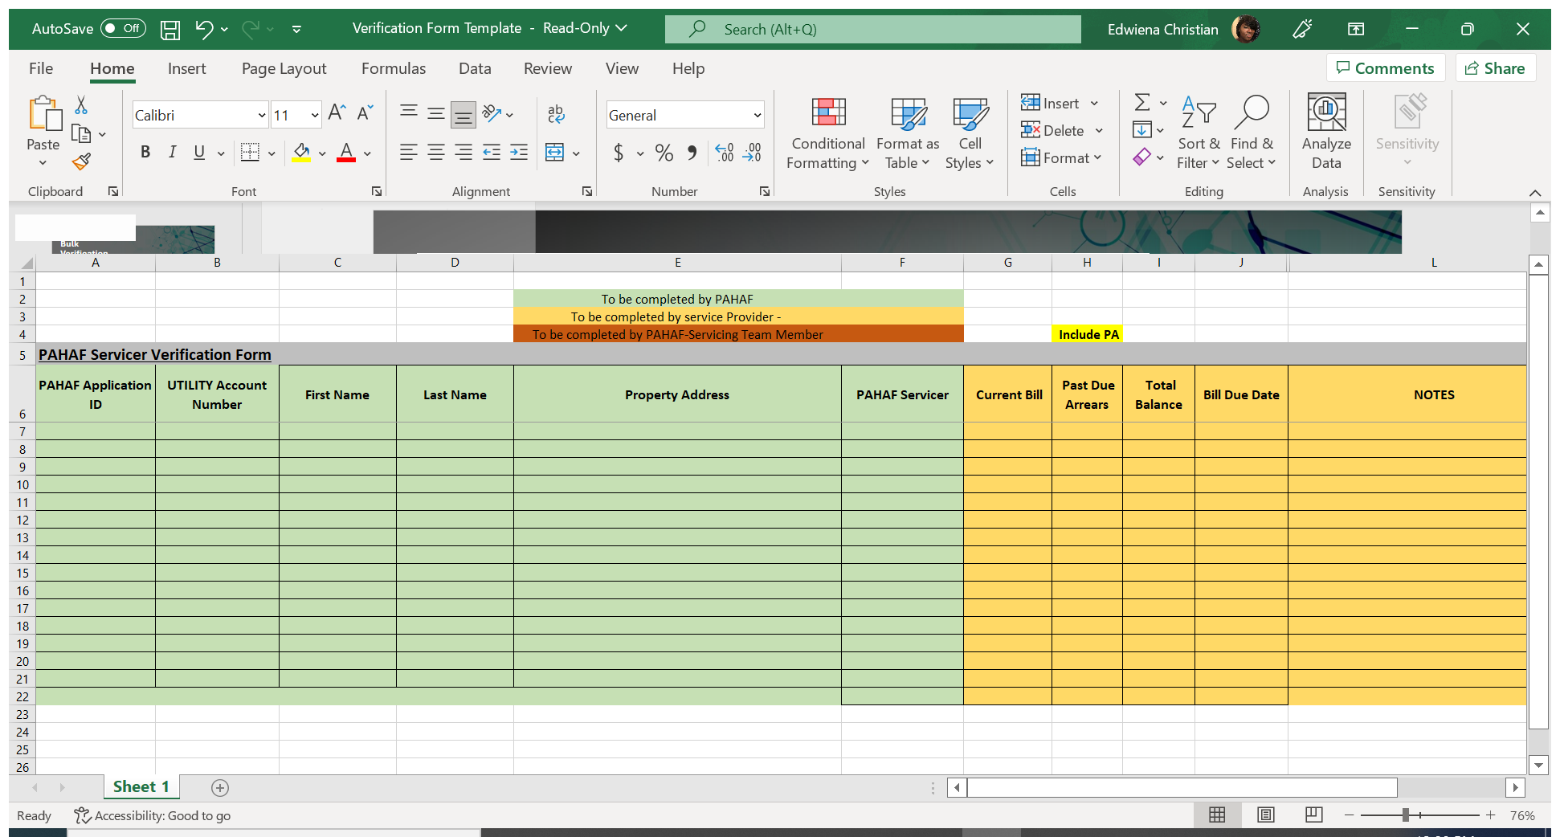
Servicer Verification Form
“The Green Section” is to be completed by the PAHAF team
The information is added to the “Servicer Verification Form”. The information on the tracker includes:
APP ID
The servicer account number
Applicant First and last name
The address
The( PAHAF servicer) verification processor

Slide 16
Servicer Verification Form
The Gold section is completed by the utility company - which include:
The current bill amount
Past due arrearage if any
And the total balance which includes arrearage, current bill, and any fees that are associated with the bill for the applicant
If the servicer want to provide additional information, they are able to add those to the note section.
For example: if the applicant is current, shut off, re-connection fees, etc

Slide 17
Servicer Verification Form
A completed verification Tracker is shown above.
Once this form is returned, the verification trackers are disbursed to the verification specialists to move the application forward.

Slide 18
Escalation Process for Utilities

Slide 19
Escalation Process
Servicing Specialist contacts utility provider to obtain latest billing statement and to attempt to postpone the shut off or have the utilities reconnected
As a servicer, we ask that you consider postponing the shut off or have utilities reconnected with a letter of participation
Rushing payments may be an option if needed
After execution of the Grant Award Letter by the applicant, a rush payment request is submitted
We may refer applicant to a Housing Counselor, Legal Services Provider or PULP (Pennsylvania Utility Law Project) to assist with delaying a shut off
Applicants should utilize their Case Manager to start the escalation process

Slide 20
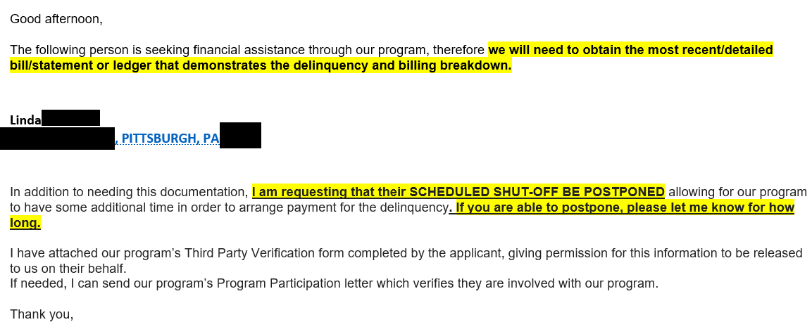
Sample Escalation Email to Utilities

Slide 21
Contact Information
Debt Verifications should be sent to:
Verification@pahaf.org
Edwiena Christian
Bulk Verification Specialist | Primary Contact
Edwiena.Christian@pahaf.org
Cheyniqua Holland
Servicing Team Lead | Escalated Contact
cheyniqua.holland@iem.com
Servicing Team Mailbox
PAHAFHELP@pahaf.org

Slide 22
For More Information
Program Information: pahaf.org
PAHAF Application Registration: register.pahaf.org
PAHAF Application Portal Log-In: apply-pa.pahaf.org
PAHAF Call Center: 888.987.2423 Open Monday through Friday from 8 a.m. to 8 p.m. and Saturday from 8 a.m. to 5 p.m.

Slide 23
Thank you for your partnering with PAHAF to help Pennsylvania homeowners
Feedback, Comments and Q&A

Slide 24
Thank You!

